Slide 1

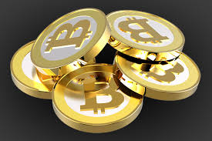
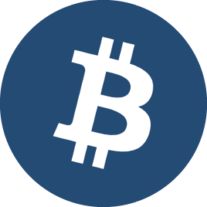
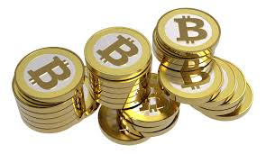
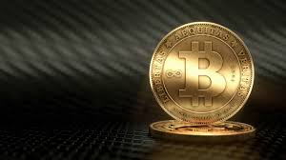
Bitcoin
Created By: CoinSecure.in

Slide 2
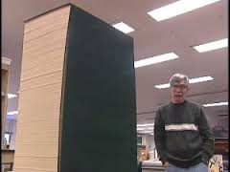

Introduction to Bitcoin
What is Bitcoin? – There’s lots to it!
Volume 1
Volume II

Slide 3



Introduction to Bitcoin contd…
Technology: Bitcoin is technology that is relatively new
Decentralized: Bitcoin is decentralized which means, nobody owns it
Futuristic:
Bitcoin is the way forward.

Slide 4
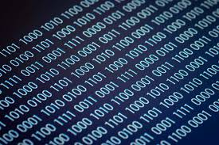

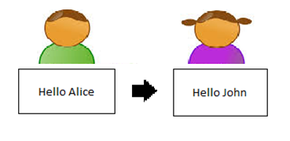
Introduction to Bitcoin contd…
Cryptographic Technology: Based on mathematics
Open Source: Its open source code (for everyone)
Peer to Peer: Can be transferred at a P2P level

Slide 5
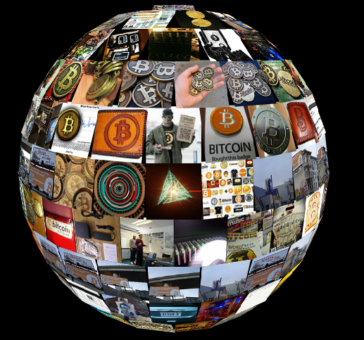
Introduction to Bitcoin contd…
It is Global !!

Slide 6

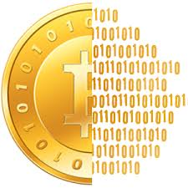
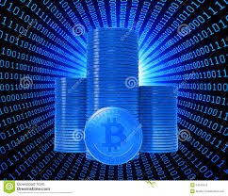
Introduction to Bitcoin contd…
Bitcoin is Virtual
Bitcoin is Digital

Slide 7

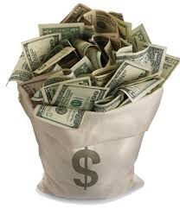
What is Bitcoin like?
Bitcoin is like E-mail
Bitcoin is like Cash

Slide 8
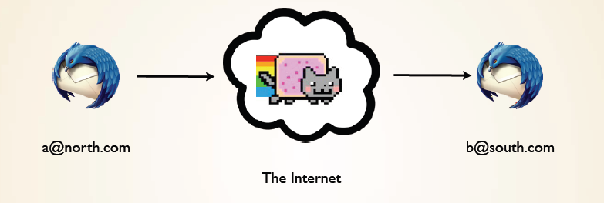
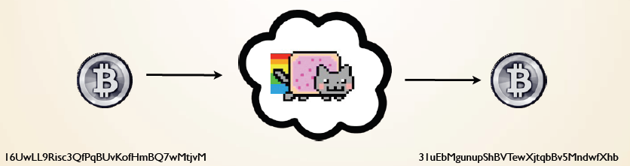
What is Bitcoin like? contd…
Bitcoin is like cash over the internet

Slide 9
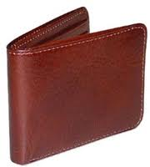
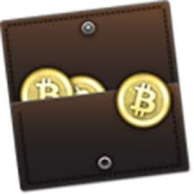
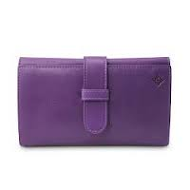
Getting Started with Bitcoins
What do I need to get started? – A Wallet!

Slide 10
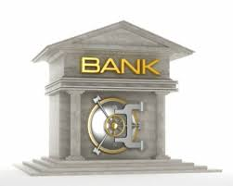

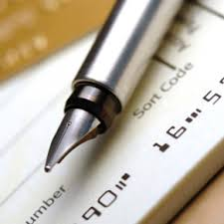
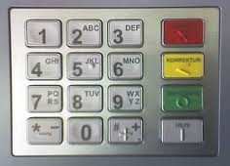
Getting Started with Bitcoins contd…
What is a Bitcoin wallet?
Wallets can be defined as a free bank where you have your money deposited and kept safe
It is stored online
It has a unique address, just like your bank account (public key)
It has a password, just like your ATM/ Internet Pin (private key)

Slide 11
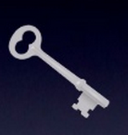

Getting Started with Bitcoins contd…
Public and Private Keys of Your Wallet
Public Key - “Bank Account”
34 characters starting with 1 or 3, represents the destination of payment
Private Key - “ATM Pin”
51 characters starting with 5, required to transfer value from the address

Slide 12


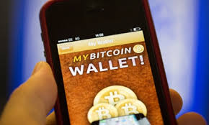
How to Create a Wallet?
Getting Started with Bitcoins contd…
Online Wallets | Offline/System Wallets | Mobile Wallets
You can create an online wallet by logging onto: http://blockchain.info http://coinbase.com | You can create offline wallets by downloading the software from: a. https://multibit.org b.http://bitcoin.org/en/download | You can create mobile wallets by downloading the software from: a.http://blockchain.info/wallet b. QT Wallet

Slide 13


How do I get Bitcoins?
Buy/ Purchase Bitcoins:
The easiest way to get Bitcoins is by purchasing them off the internet via online exchanges like:
** The above mentioned are just suggestions

Slide 14
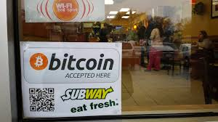

How do I get Bitcoins? contd…
Accept Bitcoin as method of payment
If you have a business, you can accept Bitcoins!!
You can accept Bitcoins in exchange of the services rendered!!

Slide 15
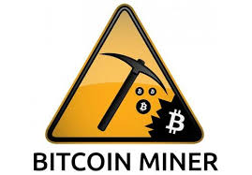
How do I get Bitcoins? contd…
You can start mining Bitcoin
What is Mining???
In lay man’s terms, mining is a process of extracting minerals and ore from the ground.
Bitcoin mining is so called because it resembles the mining of other commodities:
It requires exertion and it slowly makes new commodity available at a rate that resembles the rate at which commodities like gold are mined from the ground.

Slide 16
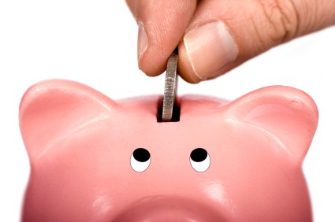
How do I get Bitcoins? contd…
What is Mining??? contd…
Explaining Mining to a 7 year old:
There’s a robot in the room that runs lotteries. Every so often, this robot randomly chooses a piggy bank in the room, and puts 50 coins in it. When it first started, there weren’t many piggy banks in the room since nobody knew about it. Back then, it was easy to win the lottery. Today, there are millions of piggy banks in the room, so your odds aren’t very good.

Slide 17

How do I get Bitcoins? contd…
What is Bitcoin Mining?
Solving a complex algorithm in the block chain
Using electricity and processing power of your system/ device
If you are the first to get the correct solution to the problem provided, you are rewarded a certain number of Bitcoin, which is 25 Bitcoins currently.

Slide 18
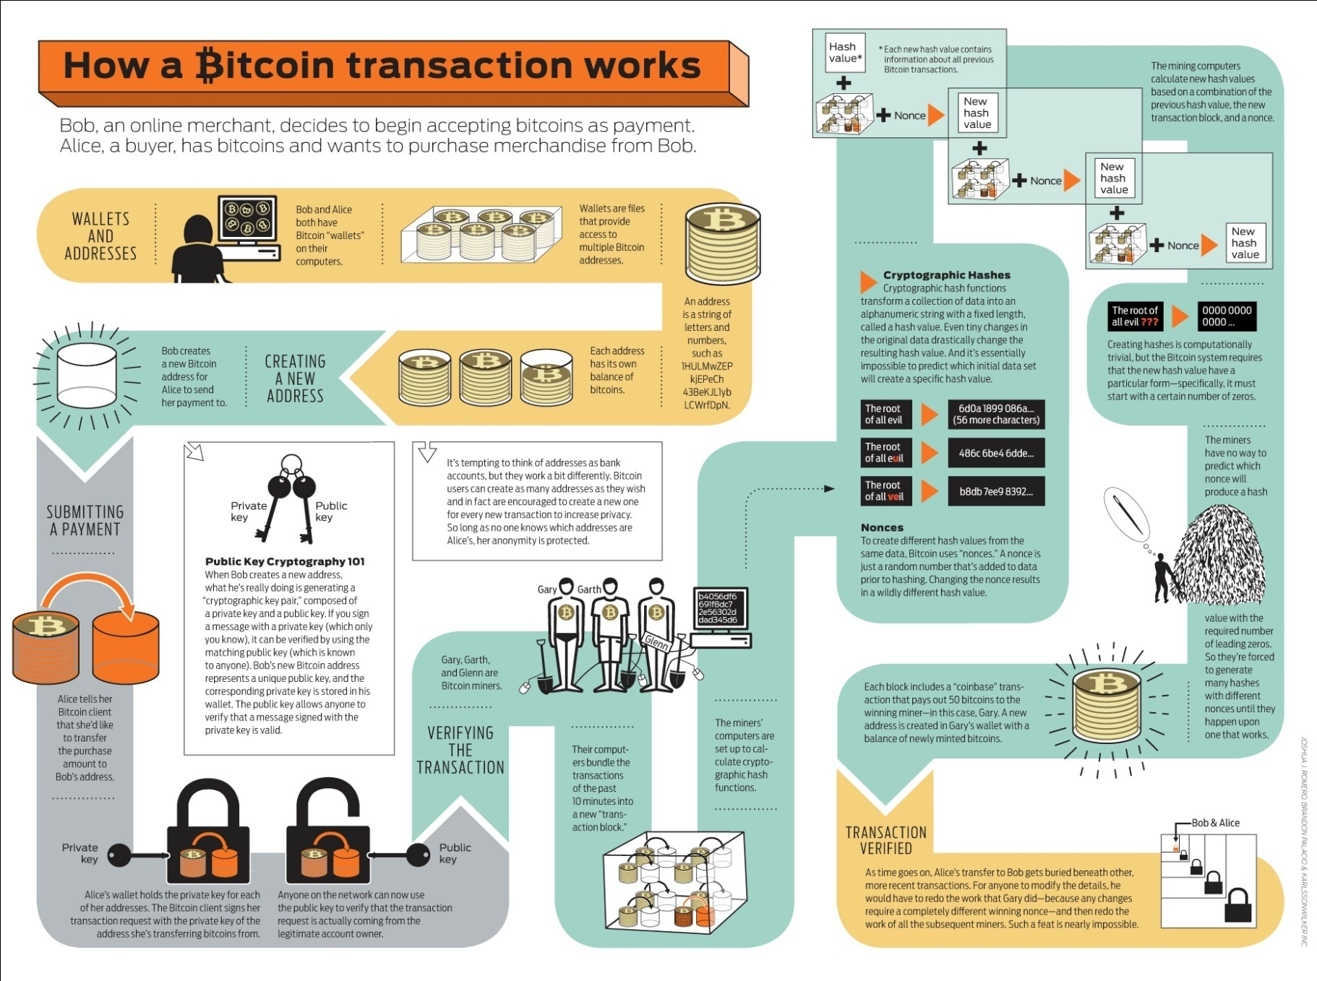
How do I get Bitcoins? contd…

Slide 19
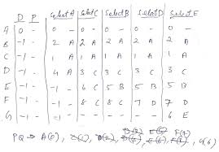


How do I get Bitcoins? contd…
How can I mine Bitcoin?
You can use pen and paper
You can use a calculator
You can use a computer

Slide 20
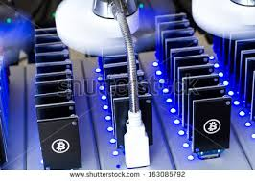
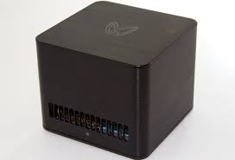
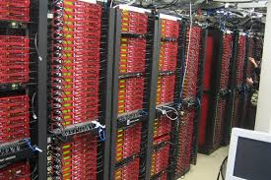
How do I get Bitcoins? contd…
You can use Bitcoin mining devices, which are specifically designed to mine Bitcoin!
Miners can be explained as devices with several chips integrated together to perform a certain task
They vary in size and performance ranging from small USB like devices that can be plugged into your computer, to large hardware that needs huge investments and space to store.
The better miner you have, the better chances of earning rewards of Bitcoin!

Slide 21
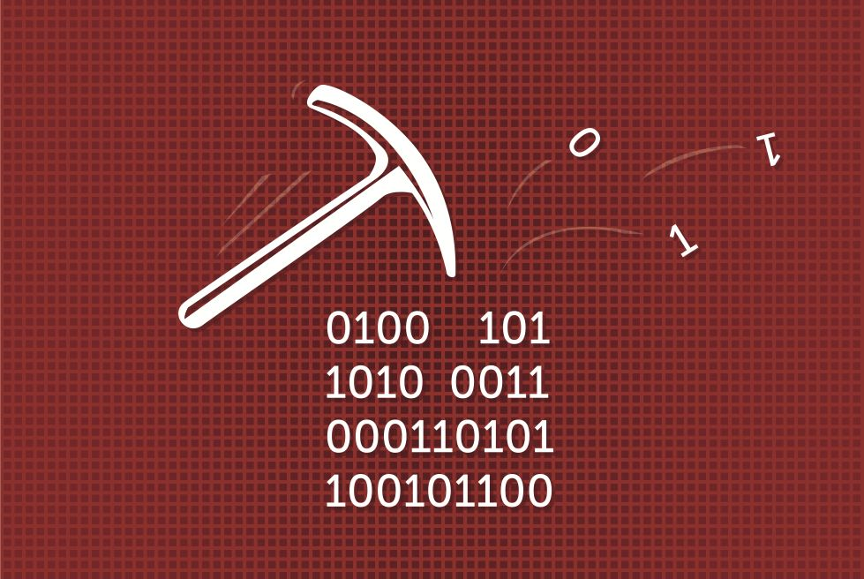
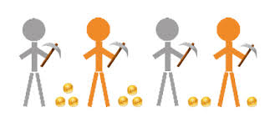
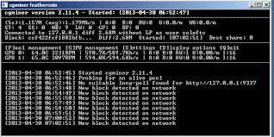
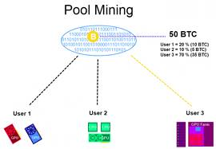
How do I get Bitcoins? contd…
Mining Bitcoins – contd…
Solo Mining – done individually
Mining Pool – done in a collective group

Slide 22
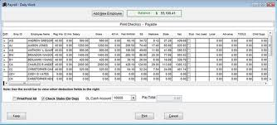
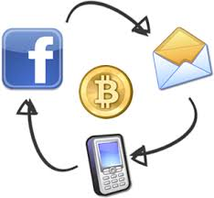
Block Chain
The block chain is a public record of Bitcoin transactions in chronological order.
The block chain is shared between all Bitcoin users.
It is used to verify Bitcoin transactions and prevents double spending

Slide 23

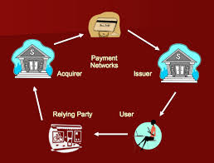

Uses of Bitcoin
Can be used as a digital currency
Can be used as a monetary system
Public verification system
Payment network
Enterprise cost center allocation and vendor management
Can be used to publicly gather input and information with an authority that cannot be censored

Slide 24
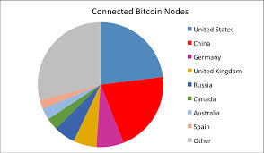
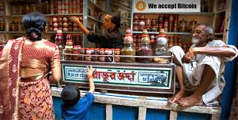
Opportunities in Bitcoin
While Bitcoin is for absolutely anybody, it is still early adoption technology.
Apart from integrating Bitcoin into any current business model, several clients can be built upon bitcoin itself to enable various services as briefly mentioned in the previous slide.

Slide 25
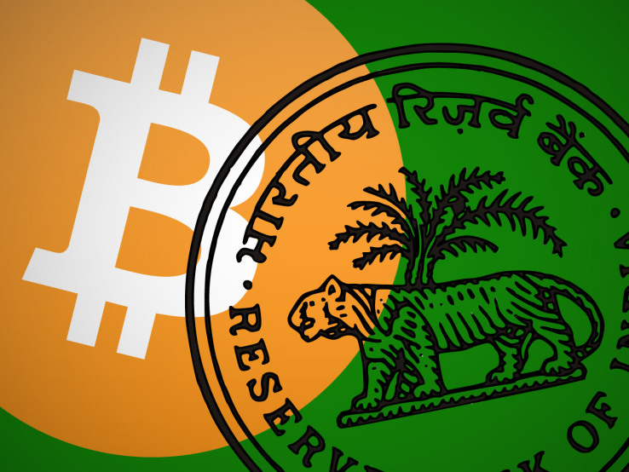
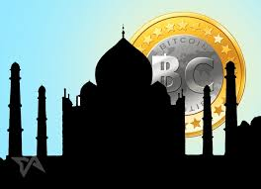
Is Bitcoin Legal in India?
The only aspect of Bitcoin in India that is under scrutiny is Trading. However, this area is slowly reviving itself after the recent fiasco.
a. According to the most comprehensive study on Bitcoin by CIS, Bitcoin does not currently fall into any category of the law.
b. RBI has issued an advisory cautioning general public against use of bitcoins and other virtual currencies – Dec 2013
c. India's central bank is "watching" Bitcoin, the virtual currency that is gaining popularity among Net users, but has no intention of regulating it right now. – Aug 2013

Slide 26
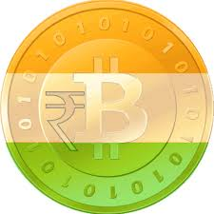
Some Important Links:
Bitcoin Website:
http://bitcoin.org/en/
Mining Video:
http://academicearth.org/electives/internet-knows-bitcoin/
India Bitcoin Face book Page:
https://www.facebook.com/IndiaBitcoin
CoinSecure Website:
http://coinsecure.in/index.php
CIS Study:
http://cis-india.org/internet-governance/bitcoin-legal-regulation-india
Bangalore Meet up Group:
http://www.meetup.com/Bangalore-Bitcoin-Creativity-Crew/

Slide 27


Slide 28


